Slide 1
CSC 480: Artificial Intelligence
Franz J. Kurfess
Professor
Computer Science Department
California Polytechnic State University
San Luis Obispo, CA, U.S.A.

Slide 2
Course Overview
Introduction
Intelligent Agents
Search
problem solving through search
uninformed search
informed search
Games
games as search problems
Knowledge and Reasoning
reasoning agents
propositional logic
predicate logic
knowledge-based systems
Learning
PAC learning
learning from observation
neural networks
Conclusions

Slide 3
Chapter Overview Learning
Motivation
Objectives
Learning from Observation
Learning Agents
Inductive Learning
Learning Decision Trees
Computational Learning Theory
Probably Approximately Correct (PAC) Learning
Learning in Neural Networks
Neurons and the Brain
Neural Networks
Perceptrons
Multi-layer Networks
Deep Learning
Applications
Important Concepts and Terms
Chapter Summary

Slide 4
Logistics
Introductions
Course Materials
textbook
handouts
Web page
CourseInfo/Blackboard System
Term Project
Lab and Homework Assignments
Exams
Grading

Slide 5
Bridge-In
“knowledge infusion” is not always the best way of providing an agent with knowledge
impractical,tedious
incomplete, imprecise, possibly incorrect
adaptivity
an agent can expand and modify its knowledge base to reflect changes
improved performance
through learning the agent can make better decisions
autonomy
without learning, an agent can hardly be considered autonomous

Slide 6
Pre-Test

Slide 7
Motivation
learning is important for agents
unknown environments
changes
performance improvement
the capability to learn is essential for the autonomy of an agent
flexible decision making
learning vs. knowledge transfer
training an agent via examples can be more efficient, but less transparent
extraction of knowledge from the examples, and transfer to the agent
agents capable of learning can improve their performance
but may require experimentation

Slide 8
Objectives
be aware of the necessity of learning for autonomous agents
understand the basic principles and limitations of inductive learning from examples
apply decision tree learning to deterministic problems characterized by Boolean functions
understand the basic learning methods of perceptrons and multi-layer neural networks
know the main advantages and problems of learning in neural networks

Slide 9
Evaluation Criteria

Slide 10
Learning
an agent tries to improve its behavior through
observation
learning from experience
memorization of past percepts, states, and actions
generalizations, identification of similar experiences
forecasting
prediction of changes in the environment
reasoning
performance improvement through generation of new knowledge
theories
generation of complex models based on observations and reasoning
reflection
analysis of past behavior

Slide 11
Learning from Observation
Learning Agents
Inductive Learning
Learning Decision Trees

Slide 12
Learning Agents
based on previous agent designs, such as reflexive, model-based, goal-based agents
those aspects of agents are encapsulated into the performance element of a learning agent
a learning agent has an additional learning element
usually used in combination with a critic and a problem generator for better learning
most agents learn from examples
inductive learning

Slide 13
Learning Agent Model
Performance
Standard
Sensors
Critic
Feedback
Changes
Learning Element
Knowledge
Performance Element
Learning
Goals
Problem Generator
Agent
Effectors
Environment

Slide 14
Components Learning Agent
learning element
performance element
critic
problem generator

Slide 15
Learning Element
responsible for making improvements
uses knowledge about the agent and feedback on its actions to improve performance

Slide 16
Performance Element
selects external actions
collects percepts, decides on actions
incorporated most aspects of our previous agent design

Slide 17
Critic
informs the learning element about the performance of the action
must use a fixed standard of performance
should be from the outside
an internal standard could be modified to improve performance
sometimes used by humans to justify or disguise low performance

Slide 18
Problem Generator
suggests actions that might lead to new experiences
may lead to some sub-optimal decisions in the short run
in the long run, hopefully better actions may be discovered
otherwise no exploration would occur

Slide 19
Learning Element Design Issues
selections of the components of the performance elements that are to be improved
representation mechanisms used in those components
availability of feedback
availability of prior information

Slide 20
Performance Element Components
multitude of different designs of the performance element
corresponding to the various agent types discussed earlier
candidate components for learning
mapping from conditions to actions
methods of inferring world properties from percept sequences
changes in the world
exploration of possible actions
utility information about the desirability of world states
goals to achieve high utility values

Slide 21
Component Representation
many possible representation schemes
weighted polynomials (e.g. in utility functions for games)
propositional logic
predicate logic
probabilistic methods (e.g. belief networks)
learning methods have been explored and developed for many representation schemes

Slide 22
Forms of Learning
supervised learning
an agent tries to find a function that matches examples from a sample set
each example provides an input together with the correct output
a teacher provides feedback on the outcome
the teacher can be an outside entity, or part of the environment
un-supervised learning
the agent tries to learn from patterns without corresponding output values
reinforcement learning
the agent does not know the exact output for an input, but it receives feedback on the desirability of its behavior
the feedback can come from an outside entity, the environment, or the agent itself
the feedback may be delayed, and not follow the respective action immediately

Slide 23
Feedback
provides information about the actual outcome of actions
supervised learning
both the input and the output of a component can be perceived by the agent directly
the output may be provided by a teacher
reinforcement learning
feedback concerning the desirability of the agent’s behavior is available
not in the form of the correct output, or
not immediately
may not be directly attributable to a particular action
feedback may occur only after a sequence of actions
the agent or component knows that it did something right (or wrong), but not what specific action caused it

Slide 24


Feedback: Good Dog!
http://www.chicagonow.com/steve-dales-pet-world/files/2011/11/Good-Dog-624x936.jpg
Note: This does not constitute an endorsement of the book - I have no idea if it’s any good ...
http://blog.timesunion.com/bark/files/2013/09/Dog-training.jpg

Slide 25


Feedback: Bad Dog!
http://lh6.ggpht.com/-GsJHh_ldX0Y/T-nODDu4opI/AAAAAAAAB-8/7R5_8V3RIzk/OHI0134-WordlessBadDog-500w.jpg?imgmax=800
http://img.geocaching.com/cache/ee912929-6c68-424f-b938-a6126ba53ed3.jpg
http://www.barbarabergstendesigns.com/S20%20No%20No%20Bad%20Dog%20Needlepoint%20Saying.jpg
http://designapplause.com/wp-content/xG58hlz9/2013/03/baddog1.png

Slide 26
Prior Knowledge
background knowledge available before a task is tackled
can increase performance or decrease learning time considerably
many learning schemes assume that no prior knowledge is available
in reality, some prior knowledge is almost always available
but often in a form that is not immediately usable by the agent

Slide 27
Inductive Learning
tries to find a function h (the hypothesis) that approximates a set of samples defining a function f
the samples are usually provided as input-output pairs (x, f(x))
supervised learning method
relies on inductive inference, or induction
conclusions are drawn from specific instances to more general statements

Slide 28
Hypotheses
finding a suitable hypothesis can be difficult
since the function f is unknown, it is hard to tell if the hypothesis h is a good approximation
the hypothesis space describes the set of hypotheses under consideration
e.g. polynomials, sinusoidal functions, propositional logic, predicate logic, ...
the choice of the hypothesis space can strongly influence the task of finding a suitable function
while a very general hypothesis space (e.g. Turing machines) may be guaranteed to contain a suitable function, it can be difficult to find it
Ockham’s razor: if multiple hypotheses are consistent with the data, choose the simplest one

Slide 29
Example Inductive Learning 1
f(x)
input-output pairs displayed as points in a plane
the task is to find a hypothesis (function) that connects the points
either all of them, or most of them
“close enough” often is sufficient
various performance measures
number of points connected
minimal surface
lowest tension
x

Slide 30
Example Inductive Learning 2
f(x)
hypothesis is a function consisting of linear segments
fully incorporates all sample pairs
goes through all points
very easy to calculate
has discontinuities at the joints of the segments
moderate predictive performance
x

Slide 31
Example Inductive Learning 3
f(x)
hypothesis expressed as a polynomial function
incorporates all samples
more complicated to calculate than linear segments
no discontinuities
better predictive power
x

Slide 32
Example Inductive Learning 4
f(x)
hypothesis is a linear function
does not incorporate all samples
extremely easy to compute
low predictive power
unless the hidden function is linear
x

Slide 33
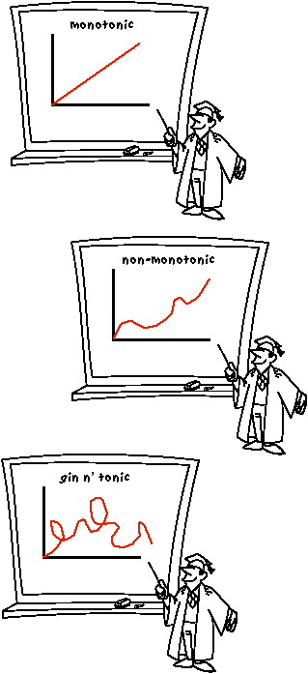
(Non-) monotonic
Lab 10 Submission: AI and Humor -> Marvin Minksy's Sense of Humor & Toons
by Christina Taggart - Tuesday, November 20, 2012, 10:33 PM
http://aitopics.net/Nonmonotonicity

Slide 34
Learning and Decision Trees
based on a set of attributes as input, predicted output value, the decision is learned
it is called classification learning for discrete values
regression for continuous values
Boolean or binary classification
output values are true or false
conceptually the simplest case, but still quite powerful
making decisions
a sequence of test is performed, testing the value of one of the attributes in each step
when a leaf node is reached, its value is returned
good correspondence to human decision-making

Slide 35
Boolean Decision Trees
compute yes/no decisions based on sets of desirable or undesirable properties of an object or a situation
each node in the tree reflects one yes/no decision based on a test of the value of one property of the object
the root node is the starting point
leaf nodes represent the possible final decisions
branches are labeled with possible values
the learning aspect is to predict the value of a goal predicate (also called goal concept)
a hypothesis is formulated as a function that defines the goal predicate

Slide 36
Decision Tree Examples
U of Notre Dame “Online Postings” decision tree
Cisco Ethics Decision Tree
TreePlan Decision Tree Learning for MS Excel

Slide 37
U of Notre Dame Online Postings Decision Tree
http://uc.nd.edu/assets/103716/original/nd_social_media_decision_tree_lg.jpg

Slide 38
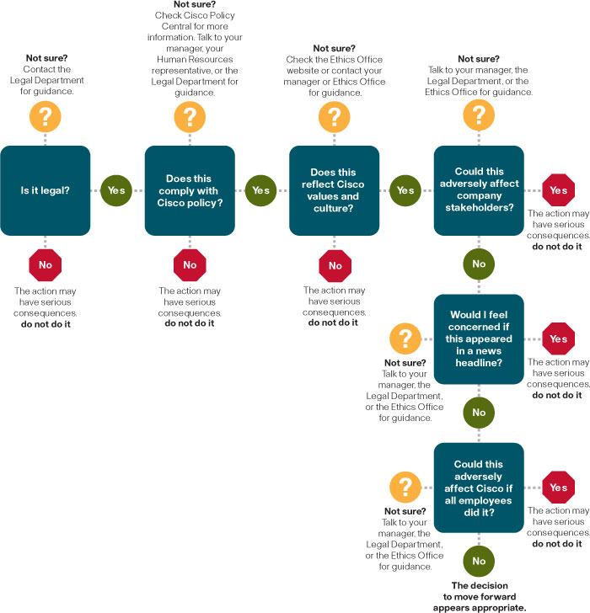
Cisco Ethics Decision Tree
http://www.cisco.com/web/about/citizenship/ethics/images/EthicsDecisionTree.jpg

Slide 39
TreePlan Decision Tree Learning for MS Excel
http://www.treeplan.com/images/treeplan-decision-tree-diagram.gif

Slide 40
Terminology
example or sample
describes the values of the attributes and the goal
a positive sample has the value true for the goal predicate, a negative sample false
sample set
collection of samples used for training and validation
training
the training set consists of samples used for constructing the decision tree
validation
the test set is used to determine if the decision tree performs correctly
ideally, the test set is different from the training set

Slide 41
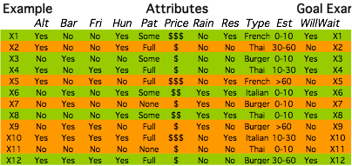
Restaurant Sample Set
Notes:
This sample set has a few non-binary attributes, such as “Patrons”, “Price”, “Type”, and “Estimated Wait”.Decision trees can handle n-ary attributes, and it is straightforward to convert them into a corresponding set of binary attributes.

Slide 42
Decision Tree Example
Patrons?
None
Full
Some
No
Yes
EstWait?
0-10
30-60
> 60
10-30
Yes
Hungry?
Bar?
No
No
Yes
No
Yes
Yes
Alternative?
No
Alternative?
No
No
Yes
Yes
Yes
Walkable?
Yes
Driveable?
No
Yes
No
Yes
Yes
No
Yes
No
To wait, or not to wait?
Notes:
This decision tree is human-generated, and has a few inconsistencies with the data set. For example, “Alternative”, “Walkable”, and “Driveable” are variations of the same attribute.

Slide 43
Decision Tree Exercise
Formulate a decision tree for the following question: Should I take the opportunity to eliminate a low score in an assignment by doing an extra task?
some possible criteria
need for improvement
amount of work required
deadline
other obligations

Slide 44
Expressiveness of Decision Trees
decision trees can also be expressed in logic as implication sentences
in principle, they can express propositional logic sentences
each row in the truth table of a sentence can be represented as a path in the tree
often there are more efficient trees
some functions require exponentially large decision trees
parity function, majority function

Slide 45
Learning Decision Trees
problem: find a decision tree that agrees with the training set
trivial solution: construct a tree with one branch for each sample of the training set
works perfectly for the samples in the training set
may not work well for new samples (generalization)
results in relatively large trees
better solution: find a concise tree that still agrees with all samples
corresponds to the simplest hypothesis that is consistent with the training set

Slide 46

Ockham’s Razor
William of Ockham (Occam)
The most likely hypothesis is the simplest one
that is consistent
with all observations.
general principle for inductive learning
a simple hypothesis that is consistent with all observations is more likely to be correct than a complex one
question: How does one measure the simplicity of a hypothesis?
http://upload.wikimedia.org/wikipedia/commons/7/70/William_of_Ockham.png

Slide 47
Constructing Decision Trees
in general, constructing the smallest possible decision tree is an intractable problem
algorithms exist for constructing reasonably small trees
basic idea: test the most important attribute first
attribute that makes the most difference for the classification of an example
can be determined through information theory
hopefully will yield the correct classification with few tests

Slide 48

Decision Tree Implementations
Weka tool set
Mark Hall, Eibe Frank, Geoffrey Holmes, Bernhard Pfahringer, Peter Reutemann, Ian H. Witten (2009); The WEKA Data Mining Software: An Update; SIGKDD Explorations, Volume 11, Issue 1.
R programming language
Orange
component-based data mining and machine learning software suite
visual programming front-end for explorative data analysis and visualization
Python bindings and libraries for scripting
http://www.cs.waikato.ac.nz/ml/weka/citing.html

Slide 49
Logistics - Nov. 15, 2012
AI Nugget presentations scheduled
Section 1:
Forrest Reiling: Interaction between Humans and Machines (delayed from Nov. 15)
Christina Taggart: Matching Up Disease Genes (delayed to Nov. 27)
Section 3:
Eric Johnson: Computer Vision for Potatoes
Vansteenwyk, Donald W.: Crosswords and Computers (delayed from Nov. 6; standby)
Steve Choo: AI and Space Exploration (special arrangements, starting Nov. 15)
Project
Project displays on Thu, Nov. 29
arrangements same as mid-quarter displays
Quiz
Quiz 9 available later today, until Wed night (11:55pm)
Make-up quiz available Tue, Dec. 4, 7am - 7pm
Labs
Lab 9 (Decision Tree Learning)
Lab 10 (AI and Humor)
A2 Demos
Section 1: today, 11:00 - noon
Section 3: today, lab hours

Slide 50
Decision Tree Algorithm
recursive formulation
select the best attribute to split positive and negative examples
if only positive or only negative examples are left, we are done
if no examples are left, no such examples were observed
return a default value calculated from the majority classification at the node’s parent
if we have positive and negative examples left, but no attributes to split them, we are in trouble
samples have the same description, but different classifications
may be caused by incorrect data (noise), or by a lack of information, or by a truly non-deterministic domain

Slide 51
Logistics - Nov. 26, 2013
Labs
Lab 10 AI and Humor
due today
Quiz
Quiz 9 - Learning : today + all day tomorrow
Make-up quiz: Thu, Dec 12, 7:10 AM - 7:00 PM
A2 Wumpus World
Demos in lab
CSC 484 W13 User-Centered Design and Development
possible continuation of projects from this class
emphasis on user interaction
Project
end-of-quarter project displays
Thu, Dec 5, lecture + lab time
space assignments as for the mid-quarter event (see next slide)

Slide 52
Project Displays
Morning Section
Afternoon Section
Team 10
Team 2
Team 17
Team 3
Team 8
Team 4
Team 14
Team 12
Team 16
Team 19
Team 6
Team 13
Team 18
Team 1
Team 11
Team 9
Team 15
Team 5
Team 7

Slide 53
Logistics cont.
AI Nugget presentations
Section 1
Brandon Ivy: Google’s Quantum AI Lab
Minnal Kunnan: Lojban
Section 3
Brian Burnett: Teaching Computers to See (Standby)
Taylor Nesheim: Distributed Artificial Intelligence
Chris Hartley: CAPTCHA, reCAPTCHA, and Duolingo

Slide 54
Restaurant Example
Decision Tree Learning
data set
human approach
human-generated decision tree
learning approach
algorithmically generated tree

Slide 55
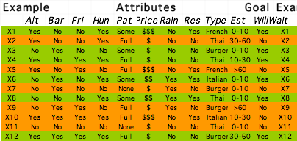
Restaurant Sample Set

Slide 56
Restaurant Sample Set
select best attribute
candidate 1: Pat Some and None in agreement with goal
candidate 2: Type No values in agreement with goal

Slide 57
Partial Decision Tree
Patrons needs further discrimination only for the Full value
None and Some agree with the WillWait goal predicate
the next step will be performed on the remaining samples for the Full value of Patrons
X1, X3, X4, X6, X8, X12
X2, X5, X7, X9, X10, X11
Patrons?
None
Full
Some
X7, X11
X1, X3, X6, X8
X4, X12
X2, X5, X9, X10
No
Yes

Slide 58
Restaurant Sample Set
select next best attribute
candidate 1: Hungry No in agreement with goal
candidate 2: Type No values in agreement with goal

Slide 59
Partial Decision Tree
Hungry needs further discrimination only for the Yes value
No agrees with the WillWait goal predicate
the next step will be performed on the remaining samples for the Yes value of Hungry
X1, X3, X4, X6, X8, X12
X2, X5, X7, X9, X10, X11
Patrons?
None
Full
Some
X7, X11
X1, X3, X6, X8
X4, X12
X2, X5, X9, X10
Yes
No
Hungry?
Y
N
X4, X12
X5, X9
X2, X10
No

Slide 60
Restaurant Sample Set
select next best attribute
candidate 1: Type Italian, Burger in agreement with goal
candidate 2: Friday No in agreement with goal

Slide 61
Partial Decision Tree
X1, X3, X4, X6, X8, X12
X2, X5, X7, X9, X10, X11
Hungry needs further discrimination only for the Yes value
No agrees with the WillWait goal predicate
the next step will be performed on the remaining samples for the Yes value of Hungry
Patrons?
None
Full
Some
X7, X11
X1, X3, X6, X8
X4, X12
X2, X5, X9, X10
Yes
No
Hungry?
Y
N
X4, X12
X5, X9
X2, X10
Type?
No
French
Thai
Burger
Ital.
Yes
X10
X4
X12
X2
No
Yes

Slide 62
Restaurant Sample Set
select next best attribute
candidate 1: Friday Yes and No in agreement with goal

Slide 63
Decision Tree
X1, X3, X4, X6, X8, X12
X2, X5, X7, X9, X10, X11
Patrons?
None
Some
Full
X7, X11
X1, X3, X6, X8
X4, X12
the two remaining samples can be made consistent by selecting Friday as the next predicate
no more samples left
X2, X5, X9, X10
Yes
No
Hungry?
Y
N
X4, X12
X5, X9
X2, X10
Type?
No
French
Ital.
Burger
Thai
Yes
X10
X4
X12
X2
No
Yes
Friday?
Y
N
X4
X2
Yes
No

Slide 64
Performance of Decision Tree Learning
quality of predictions
predictions for the classification of unknown examples that agree with the correct result are obviously better
can be measured easily after the fact
it can be assessed in advance by splitting the available examples into a training set and a test set
learn the training set, and assess the performance via the test set
size of the tree
a smaller tree (especially depth-wise) is a more concise representation

Slide 65
Noise and Over-fitting
the presence of irrelevant attributes (“noise”) may lead to more degrees of freedom in the decision tree
the hypothesis space is unnecessarily large
overfitting makes use of irrelevant attributes to distinguish between samples that have no meaningful differences
e.g. using the day of the week when rolling dice
over-fitting is a general problem for all learning algorithms
decision tree pruning identifies attributes that are likely to be irrelevant
very low information gain
cross-validation splits the sample data in different training and test sets
results are averaged

Slide 66
Ensemble Learning
multiple hypotheses (an ensemble) are generated, and their predictions combined
by using multiple hypotheses, the likelihood for misclassification is hopefully lower
also enlarges the hypothesis space
boosting is a frequently used ensemble method
each example in the training set has a weight associated
the weights of incorrectly classified examples are increased, and a new hypothesis is generated from this new weighted training set
the final hypothesis is a weighted-majority combination of all the generated hypotheses

Slide 67
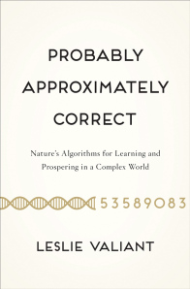
Computational Learning Theory (COLT)
Background
PAC Learning
http://onionesquereality.files.wordpress.com/2013/08/valiant-probably_approximately_correct.jpg?w=196&h=300

Slide 68
Computational Learning Theory
relies on methods and techniques from theoretical computer science, statistics, and AI
used for the formal analysis of learning algorithms
basic principles
a hypothesis is seriously wrong
it will most likely generate a false prediction even for small numbers of examples
hypothesis is consistent with a large number of examples
most likely it is quite good, or probably approximately correct

Slide 69
Probably Approximately Correct (PAC) Learning
approximately correct hypothesis
its error lies within a small constant of the true result
by testing a sufficient number of examples, one can see if a hypothesis has a high probability of being approximately correct
stationary assumption
training and test sets follow the same probability distribution
there is a connection between the past (known) and the future (unknown)
a selection of non-representative examples will not result in good learning

Slide 70
Learning in Neural Networks
Neurons and the Brain
Neural Networks
Perceptrons
Multi-layer Networks
Applications

Slide 71
Neural Networks
complex networks of simple computing elements
capable of learning from examples
with appropriate learning methods
collection of simple elements performs high-level operations
thought
reasoning
consciousness

Slide 72
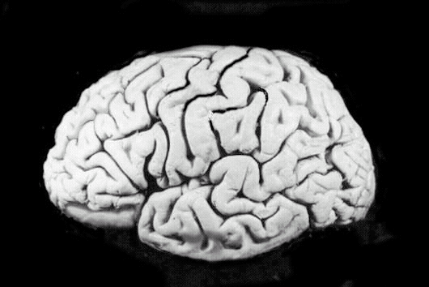
Neural Networks and the Brain
brain
set of interconnected modules
performs information processing operations at various levels
sensory input analysis
memory storage and retrieval
reasoning
feelings
consciousness
neurons
basic computational elements
heavily interconnected with other neurons
[Russell & Norvig, 1995]

Slide 73
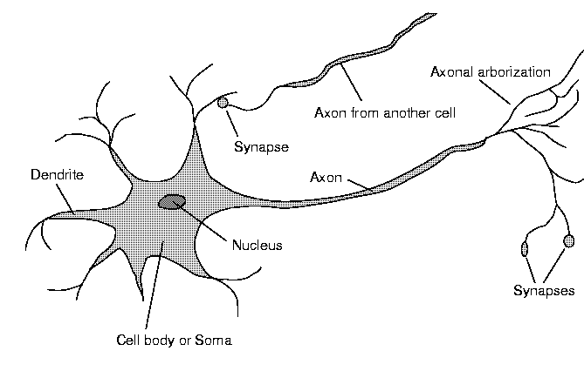
Neuron Diagram
soma
cell body
dendrites
incoming branches
axon
outgoing branch
synapse
junction between a dendrite and an axon from another neuron
[Russell & Norvig, 1995]

Slide 74
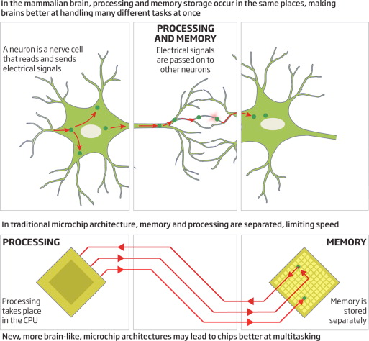
Brain vs. Computer
Peter Norvig, Artificial intelligence: A new future, New Scientist, Volume 216, Issue 2889, 3 November 2012, Pages vi-vii, ISSN 0262-4079, 10.1016/S0262-4079(12)62785-7.
(http://www.sciencedirect.com/science/article/pii/S0262407912627857)
http://ars.els-cdn.com/content/image/1-s2.0-S0262407912627857-gr1.jpg

Slide 75
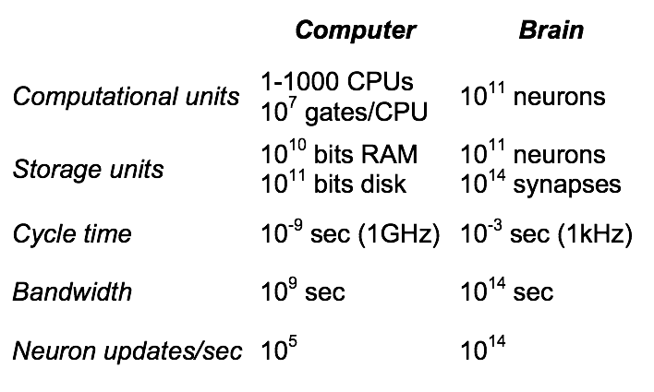
Computer vs. Brain: Performance

Slide 76

Computer Brain vs. Cat Brain
in 2009 IBM makes a supercomputer “significantly smarter than a cat”
“IBM has announced a software simulation of a mammalian cerebral cortex that's significantly more complex than the cortex of a cat. And, just like the actual brain that it simulates, they still have to figure out how it works.”
http://arstechnica.com/science/news/2009/11/ibm-makes-supercomputer-significantly-smarter-than-cat.ars?utm_source=rss&utm_medium=rss&utm_campaign=rss
http://static.arstechnica.com/cat_computer_ars.jpg

Slide 77
Google Neural Network learns about ???
What does a really large NN learn from watching Youtube videos for one week?
NN implementation
computation spread across 16,000 CPU cores
more than 1 billion connections in the NN
http://googleblog.blogspot.com/2012/06/using-large-scale-brain-simulations-for.html

Slide 78
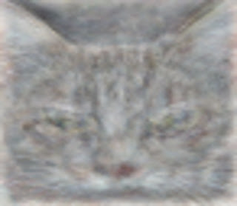
Cat Discovery
“cat” discovery in NN
learned to identify a category of images with cats
Google blog post
https://plus.google.com/u/0/+ResearchatGoogle/posts/EMyhnBetd2F
published paper
http://static.googleusercontent.com/external_content/untrusted_dlcp/research.google.com/en/us/archive/unsupervised_icml2012.pdf
http://1.bp.blogspot.com/-VENOsYD1uJc/T-nkLAiANtI/AAAAAAAAJWc/2KCTl3OsI18/s1600/cat+detection.jpeg

Slide 79
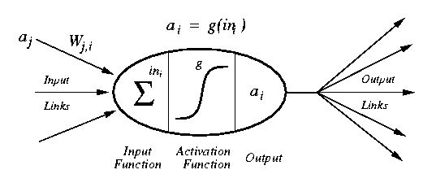
Artificial Neuron Diagram
weighted inputs are summed up by the input function
the (nonlinear) activation function calculates the activation value, which determines the output
[Russell & Norvig, 1995]

Slide 80
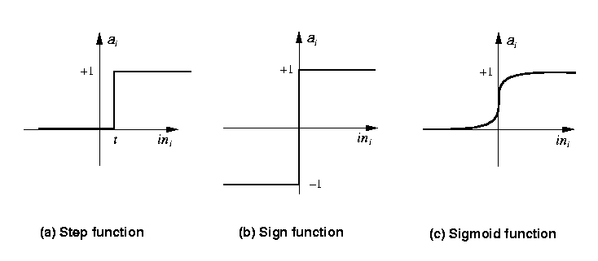
Common Activation Functions
[Russell & Norvig, 1995]
Step_{t}(x) = 1 if x >= t, else 0
Sign(x) = +1 if x >= 0, else –1
Sigmoid(x) = 1/(1+e^{-x})

Slide 81
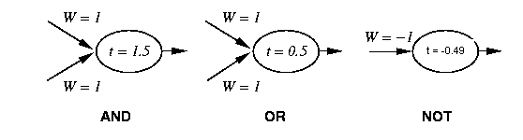
Neural Networks and Logic Gates
simple neurons with can act as logic gates
appropriate choice of activation function, threshold, and weights
step function as activation function
[Russell & Norvig, 1995]

Slide 82
Network Structures
in principle, networks can be arbitrarily connected
occasionally done to represent specific structures
semantic networks
logical sentences
makes learning rather difficult
layered structures
networks are arranged into layers
interconnections mostly between two layers
some networks have feedback connections

Slide 83
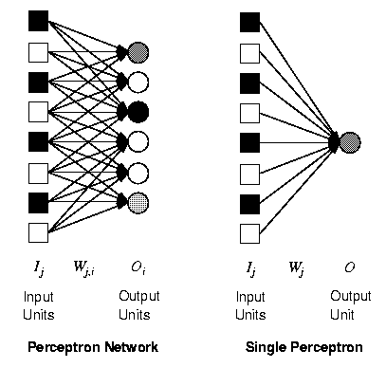
Perceptrons
single layer, feed-forward network
historically one of the first types of neural networks
late 1950s
the output is calculated as a step function applied to the weighted sum of inputs
capable of learning simple functions
linearly separable
[Russell & Norvig, 1995]

Slide 84
Perceptrons and Linear Separability
perceptrons can deal with linearly separable functions
some simple functions are not linearly separable
XOR function
0,1
1,1
0,1
1,1
0,0
1,0
0,0
1,0
AND
XOR
[Russell & Norvig, 1995]

Slide 85
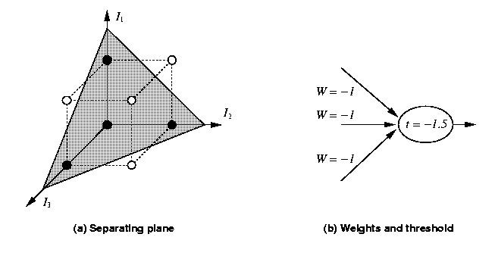
Perceptrons and Linear Separability
linear separability can be extended to more than two dimensions
more difficult to visualize
[Russell & Norvig, 1995]

Slide 86
Perceptrons and Learning
perceptrons can learn from examples through a simple learning rule
calculate the error of a unit Err_{i} as the difference between the correct output T_{i} and the calculated output O_{i} Err_{i} = T_{i} - O_{i}
adjust the weight W_{j} of the input I_{j} such that the error decreases W_{ij} := W_{ij} + α *I_{ij} * Err_{ij}
α is the learning rate
this is a gradient descent search through the weight space
lead to great enthusiasm in the late 50s and early 60s until Minsky & Papert in 69 analyzed the class of representable functions and found the linear separability problem

Slide 87
Generic Neural Network Learning
basic framework for learning in neural networks
function NEURAL-NETWORK-LEARNING(examples) returns network
network := a network with randomly assigned weights
for each e in examples do
O := NEURAL-NETWORK-OUTPUT(network,e)
T := observed output values from e
update the weights in network based on e, O, and T
return network
adjust the weights until the predicted output values O
and the observed values T agree

Slide 88
Multi-Layer Networks
research in the more complex networks with more than one layer was very limited until the 1980s
learning in such networks is much more complicated
the problem is to assign the blame for an error to the respective units and their weights in a constructive way
the back-propagation learning algorithm can be used to facilitate learning in multi-layer networks

Slide 89
Diagram Multi-Layer Network
two-layer network
input units Ik
usually not counted as a separate layer
hidden units aj
output units Oi
usually all nodes of one layer have weighted connections to all nodes of the next layer
O_{i}
W_{ji}
a_{j}
W_{kj}
I_{k}

Slide 90
Back-Propagation Algorithm
assigns blame to individual units in the respective layers
essentially based on the connection strength
proceeds from the output layer to the hidden layer(s)
updates the weights of the units leading to the layer
essentially performs gradient-descent search on the error surface
relatively simple since it relies only on local information from directly connected units
has convergence and efficiency problems

Slide 91
Capabilities of
Multi-Layer Neural Networks
expressiveness
weaker than predicate logic
good for continuous inputs and outputs
computational efficiency
training time can be exponential in the number of inputs
depends critically on parameters like the learning rate
local minima are problematic
can be overcome by simulated annealing, at additional cost
generalization
works reasonably well for some functions (classes of problems)
no formal characterization of these functions

Slide 92
Capabilities of Multi-Layer Neural Networks (cont.)
sensitivity to noise
very tolerant
they perform nonlinear regression
transparency
neural networks are essentially black boxes
there is no explanation or trace for a particular answer
tools for the analysis of networks are very limited
some limited methods to extract rules from networks
prior knowledge
very difficult to integrate since the internal representation of the networks is not easily accessible

Slide 93
Deep Learning
are part of the broader machine learning field of learning representations of data
cascade of many layers of nonlinear processing units for feature extraction and transformation
each successive layer uses the output from the previous layer as input
algorithms may be supervised or unsupervised
applications include pattern recognition and statistical classification
based on the (unsupervised) learning of multiple levels of features or representations of the data
higher level features are derived from lower level features to form a hierarchical representation
learn multiple levels of representations
correspond to different levels of abstraction
the levels form a hierarchy of concepts
can be computationally very expensive
very large data sets
complex algorithms
https://en.wikipedia.org/wiki/Deep_learning
J. Schmidhuber, "Deep Learning in Neural Networks: An Overview" http://arxiv.org/abs/1404.7828, 2014

Slide 94
Why Deep Learning?
Machine learning
just optimizing weights to make a final prediction
human-designed representations and input features
internal representation nevertheless not very transparent
Representation learning
attempts to automatically learn good features or representations
Deep learning algorithms
attempt to learn multiple levels of representation of increasing complexity/abstraction

Slide 95
Deep Learning Architectures
deep belief networks
Markov Random Fields with multiple layers
multi-layer neural networks for supervised learning
input layer
sensory inputs
hidden layers
more abstract representations for higher levels
output layer
prediction of a supervised target

Slide 96
Deep Learning Advantages
learning representations
instead of hand-crafted features that are often domain-specific, incomplete, over-specified, time-consuming to develop, subjective
distributed vs. symbolic representations
traditional systems represent one conceptual entity (object, word, number, etc.) as one “chunk” (instance of a data structure, record)
similar conceptual entity may have completely different representations
distributed representations “spread out” the storage of entities (“sparse” representations)
multiple storage “chunks” contain parts of multiple conceptual entities
similarity becomes an inherent property of the representation
multiple dimensions of similarity are possible
for words, similarity for both spelling and meaning can be incorporated
distributed representations facilitate multi-clustering
categorize entities according do multiple features often works better than local clustering (e.g. nearest-neighbor)
distributed representations reduce the “curse of dimensionality”
generalizing locally requires representative examples for all relevant variations, covering all dimensions in the feature space

Slide 97
Deep Learning Advantages (cont.)
unsupervised learning
both for features and for weights
in many domains, many to most data sets are unlabeled
e.g., Natural Language Processing: text documents don’t have annotations about sentence structure and meaning
good data models can help with learning
data models can still be a challenge to obtain or create
multiple levels of representation
good intermediate representations
can be shared across tasks
capture some aspects of the domain
related to the “depth” of a domain or data model
higher model layers learn more abstract intermediate representations
may increase comprehensibility for humans
can help with compositionality

Slide 98
Deep Learning Success
related ideas have been explored for some time
connectionism
parallel distributed processing
sparse encoding
associative memory
…
practical learning methods have become available since around 2006
unsupervised pre-training
better parameter estimation methods
understanding of model regularization
computing power
Google’s Deep Learning “Cat” Success in 2012
see e.g. John Markoff’s NY Times article “How Many Computers to Identify a Cat? 16,000”

Slide 99
Deep Learning and Image Processing
one of the first areas to use deep learning methods
substantial background knowledge
features at different levels of abstraction
conventional computational methods
many carefully adapted to specific circumstances
large data sets available

Slide 100
Deep Learning & NLP
Natural Language Processing is one of the areas where deep learning has been very successful
Google’s NLP efforts (probably)
Google Now
Youtube transcription service
Google phone service
Microsoft MAVIS speech recognition engine
Apple’s Siri (probably)
background material
a good overview of NLP and Deep Learning is
Deep Learning for NLP, a tutorial given at NAACL HLT 2013 by Richard Socher and Christopher Manning
Stanford course Spring 2015 by Richard Socher
“CS224d: Deep Learning for Natural Language Processing"

Slide 101
Applications
domains and tasks where neural networks are successfully used
handwriting recognition
control problems
juggling, truck backup problem
series prediction
weather, financial forecasting
categorization
sorting of items (fruit, characters, phonemes, …)

Slide 102
Post-Test

Slide 103
Evaluation
Criteria

Slide 104
Important Concepts and Terms
axon
back-propagation learning algorithm
bias
decision tree
dendrite
feedback
function approximation
generalization
gradient descent
hypothesis
inductive learning
learning element
linear separability
machine learning
multi-layer neural network
neural network
neuron
noise
Ockham’s razor
perceptron
performance element
prior knowledge
sample
synapse
test set
training set
transparency

Slide 105
Chapter Summary
learning is very important for agents to improve their decision-making process
unknown environments, changes, time constraints
most methods rely on inductive learning
a function is approximated from sample input-output pairs
decision trees are useful for learning deterministic Boolean functions
neural networks consist of simple interconnected computational elements
multi-layer feed-forward networks can learn any function
provided they have enough units and time to learn

